Slide 1
Queueing at the Tax Office
Natalie Woloszuk, Mark Villar,
Sanja Lujic and Tammie Chan

Slide 2
Presentation Structure
Brief Overview
Key Objectives
Data Review
Statistical Analysis
Recommendations
Critique

Slide 3
Background
Consultants
Richard Tweedie and Nell Hall from SIRO-MATH Pty Ltd, Australia
Client
Australian Tax Office

Slide 4
Consulting Problem
Behavioural differences of “dial-in” enquiry lines between three different offices.
In particular C seemed to have remarkably poor behaviour when compared to A and B

Slide 5
Consultants’ Task
To determine what was causing the disparity between the offices and whether or not something could be done about it.

Slide 6
Key Objectives
Are there explainable differences in the waiting times between each site?
What factors affect the waiting time?
Can the overall effectiveness of the calling system be improved?

Slide 7
Steps Taken
Step 1: Choose a model to fit the situation
- Multiserver queue or M/M/c queue
Step 2: Acquire the data to assess the model
- Obtained from ATO tracking software
Step 3: Carry out the analyses to determine model adequacy

Slide 8


The Queueing Model
Multiserver queue or M/M/c queue
M – describes the arrival process: assumed the calls follow a Poisson distribution with average rate
M – refers to the service times:
assumed that the service times were exponentially distributed with mean
c – refers the number of servers

Slide 9


Data Review
The following measures of effectiveness were used
for this observational study:
    The average length of time waiting on hold before the questions were addressed.
    The percentage of customers who waited longer than three minutes before being answered.

Slide 10
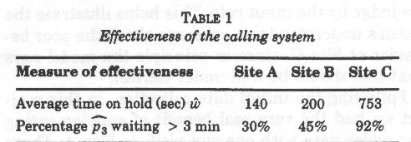
Comparing effectiveness

Slide 11

Exploratory Data Analysis
  Response variables:
    is a continuous variable measured in seconds
    is expressed as a percentage
  Explanatory variables:
    is the average rate of calls per minute
    is the mean call length measured in seconds
    is the number of servers in the enquiry room

Slide 12
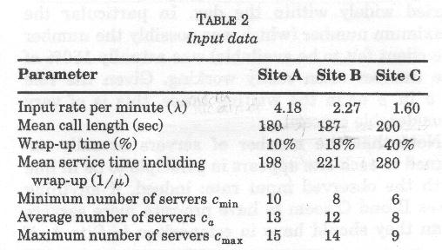
Input Data
Wrap up time - the period of time after the call when the server made notes, shifted files and so on. Modelled as a percentage of service time
Notes:
# servers actually assigned to each site appears in principle to be in line with the observed input rate. Sites B and C have more servers then they should in comparison to A
Mean call lengths are constant

Slide 13
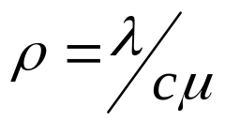


The Queueing Theory
“Critical threshold” result
Traffic intensity or load on the queue measure
Stable situation
Unstable situation : the queue grows infinitely long because customers arrive faster than they are served

Slide 14
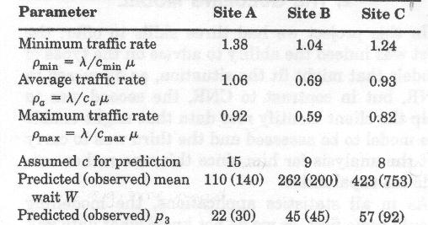
Predicted behaviour

Slide 15
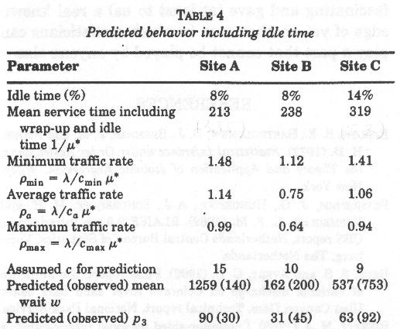
Predicted behaviour including idle time
Idle time – period of time absent from the room or inactive at the desk

Slide 16
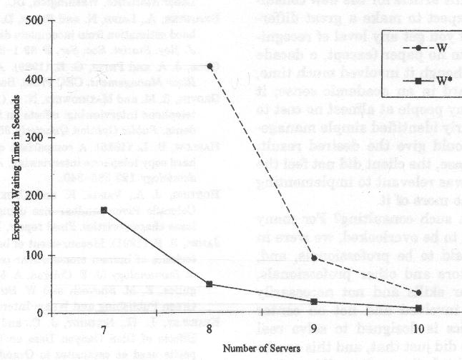
Recommendations
Add extra server at Site C
Reduce wrap up time at Site C
Predicted waiting time
Predicted waiting time with reduced wrap up time

Slide 17
Comments
Data did not match model perfectly
Results are very sensitive to model changes
Server pooling
Outcomes of the consultancy

Slide 18
Critique
Client defined performance measures
  Are these the best measures given the data?
  Other qualitative measures (quality and sufficiency of advice) could be better?
Improvement in the service?
  Is reducing the waiting time enough to improve the service?
Notes:
Site A visited, not C.

Slide 19
Critique
Data collection issues
  Call hang ups
  Provided with mean values and not actual data
  Not properly defined – over what period of time was the average computed and how it was computed?
Adequacy of the model
  Appropriateness of the exponential distribution
  M/M/c/c as alternative
  Relevance of idle time on model fitting

